Slide 1

Core Components of a UNIX Operating System
Shell(s)
Kernel
Filesystem
Programming Tools
Text Editors
Init
System
Notes:
Prep: Open VM /w /etc/fstab, open student list
First: Lets go around and share our one VIM or console trick. My trick is !!, which expands to the last command you typed.
Second: I’m going to open the floor for questions on the material for last week. Spend 15 minutes max.
… notes from video ...
Hey everybody, welcome to another exciting installment of sysadmin.. we are going to continue discussing the core components of a UNIX operating system and in this video I’m going to talk briefly about how the UNIX or Linux kernel works with storage devices, and we’ll also go over the Linux device naming conventions.
We’ve looked at a few different types of files, for example plain ol regular files, directories (yes, a directory is actually a file which contains a list of named references to files in the directory), and links, but I want to introduce you to another type of file on UNIX… this is a very special type of file. It is called a device file. Rather you realize it by now or not, but a large subset of communication is done with the kernel via files.
Every hardware device on the system can be accessed through a file…. yes, a file… from your sound card, to your hard drive…. they are communicated with through a file. Better yet, because they are a file you can use the good ol’ commands you are familiar with like cat…. if you really want to.
I know… your mind is blown because of the sheer simplicity of the whole thing right? I’m sure you don’t believe me at all right now, so lets see an example of this. Right now, I have a thumb drive connected to my windows computer… yuck… I feel so dirty using this thing… I’m really going to have to take a shower afterwards. Anyway, If we open it up, we can see one file there called test.txt, and if we look at the contents of the test.txt file we can see it has the words “this is a test in it”.
Now, lets go back to Linux… I’ve plugged this thumb drive into my Linux computer and I’m going to look at a special folder on the filesystem called /dev. This location on the filesystem contains all of the special devices files I mentioned. You’ll only find them here on most systems, and no where else on our file system tree. There is a special device file here called sdc1 which is a file for communicating with the driver, or software in the kernel that knows how to talk to my thumb drive.
If I use cat to print out the contents of that file we’ll see a bunch of junk print to the screen. This junk is the raw binary from the thumb drive. Meaning, when I read from this file from beginning to end… I’m reading the individual bits on the storage device from the start of the device, to the end of the device. Pretty cool huh? The reason why this appears as a bunch of garbage, is that cat is trying to convert the binary to something called ASCII. ASCII is just a mapping between a sequence of 8 bits, or a byte, to english alphabetic characters and some non-english alphabetic characters (for example accented letters from other languages).
So when cat reads this file, it starts with the first 8 bits, or byte and looks it up in this ASCII mapping and prints the resulting character to the screen… takes the next byte, looks it up, prints it. Sometimes the bytes are actually meant to be characters, for example the stuff I have in my text file, that string “this is a test”, those characters will show up as we’d expect…. but other times we just get a bunch of stuff that appears to us on the console as ASCII puke, or nothing at all.
We can use a different program called strings to only print stuff to the screen that looks like valid ASCII characters.
As a side note, if you ever see this junk on the screen, it means that you accidentally printed binary to the terminal… and it can sometimes mess your console up to a point where the only way you can fix it is by logging out and back in.

Slide 2
Linux Device Naming Conventions
 | First Two Letters
Mass Storage Devices SATA, SAS, SCSI, or USB | sd
Mass Storage Devices IDE/PATA | hd
CDROM or DVD Drives SATA, SAS, SCSI, USB, IDE/PATA | sr
Floppy Disks | fd
Notes:
Question: What types of files can we have on a UNIX system?
Question: If I have three internal drives connected to a Linux machine, and plug in a USB thumb drive, what name will that thumb drive be assigned?
Question: What are two ways we can get a listing of mass storage devices on the system, and the names they’ve been assigned?
Okay… moving on... you are probably wondering how on earth I knew that my thumb drive was the device file /dev/sdc1. The Linux kernel actually uses a fairly predictable naming scheme to give device files for your storage. Please note that I said this is the naming convention for the Linux kernel, other unicies have their own conventions. Please note that I also said predictable, not understandable. The naming convention will likely make as much sense as a fish riding a bicycle, so just memorize it and move on with your life.
With Linux, the first two characters in the name of the device file are pretty straight forward and easy to explain. All mass storage devices (including hard drive, ssd, etc.) using the SATA, SAS, or SCSI interface technology (e.g. the type of physical connection to the machine… look it up offline if you don’t know what they are), or any type of USB storage devices are assigned the first two characters of sd. All mass storage devices using the IDE or PATA interface technology (old, old stuff), are assigned the first two characters of hd in their device filename.
All CDROM / DVD drives regardless of their interface technology are given the first two characters of sr, and all floppy disks are given the first two characters of fd. If you don’t know what a floppy disk is…. we’ll don’t ask me because you’ll just make me feel really old and I’ll probably go on some rant

Slide 3
Linux Device Naming Conventions
 | Ordering Convention
CDROM or DVD Drives | Number after first 2 letters
Floppy Disks | Number after first 2 letters
Mass Storage Devices | One letter after first 2 letters (a, b, etc)
Notes:
Now, if you recall our path of /dev/sdc1… obviously there are still characters left in the device file name that I haven’t explained. That 3rd single character in the device filename is used to indicate which particular device we are working with. In the case of Optical Drives and Floppy disks, this is simply a number, and is usually assigned in the order the drive appears first to the BIOS… meaning… whichever one is plugged into the lower numbered SATA port on the motherboard. If it is a USB device, it will always be numbered higher than an internal device if it exists, and if there are more than one USB optical devices, they will be numbered by the order they were plugged in.
So for example, if I have one internal CDROM drive, and one external USB cdrom drive… the internal drive would be /dev/sr0 and the external would be /dev/sr1. If later on, while the computer is up and running… If I decide to plug in another external CDROM drive it would be given /dev/sr2. I’m sure you are probably wondering about what happens if I reboot the machine with all the external drives plugged in, how will the kernel know the order by which I plugged the USB cdrom drives in. And the short answer is that it depends. This crazy naming convention stuff is all handled by some software called udev, which has a set of configurable rules to try and ensure devices are kept persistent names upon reboot and when they are unplugged and plugged back in. I know on CentOS it doesn’t keep persistent names for mass storage devices upon reboot, but couldn’t tell you for sure with optical drives (I can’t say I’ve bothered to plug more than one cdrom drive into a modern linux machine).
I could literally spend 40 minutes talking about edge cases with udev, but, worst case if you can’t figure out what name has been given to a particular device…. unplug the darn thing, plug it back in, and run dmesg…. dmesg is one program to print out driver messages from the kernel and other system utilities and look at the name it has been given. In the video where I talk about mounting storage, we’ll look at a few more intelligent ways to find out which device has been given what name… but for right now this is good enough.
Before moving on, I do want to point out that mass storage devices behave the same way as optical drives, but they use letters instead of numbers. If we inspect my machine closely, we can see why my thumb drive was given /dev/sdc. We can see that I have two internal mass storage devices connected via SATA already, which are named in the kernel as sda and sdb, so when I plug in my thumb drive… it gets sdb.
But wait Mark…. back in the example, you used sdc1 what about the 1? That 1 has to do with partition numbers… and is another video in itself and we’ll worry about that later.
Okay, that is all that I have for now, which is probably far more than enough to drive you to drink… see you guys next time!

Slide 4
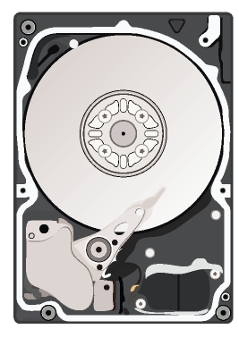
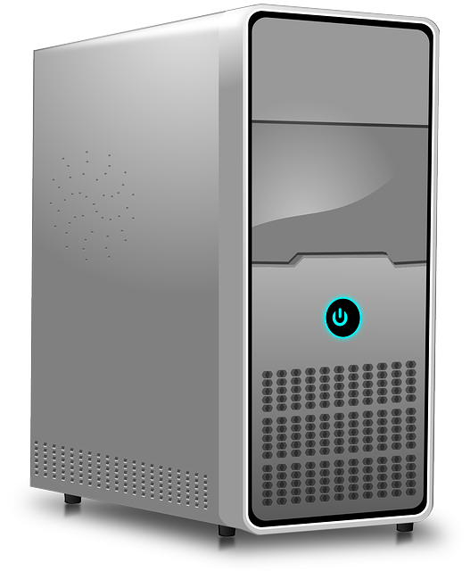
/dev/sda
/dev/sdb
Notes:
Before moving on, I do want to point out that mass storage devices behave the same way as optical drives, but they use letters instead of numbers. If we inspect my machine closely, we can see why my thumb drive was given /dev/sdc. We can see that I have two internal mass storage devices connected via SATA already, which are named in the kernel as sda and sdb, so when I plug in my thumb drive… it gets sdb.
But wait Mark…. back in the example, you used sdc1 what about the 1? That 1 has to do with partition numbers… and is another video in itself and we’ll worry about that later.
Okay, that is all that I have for now, which is probably far more than enough to drive you to drink… see you guys next time!

Slide 5
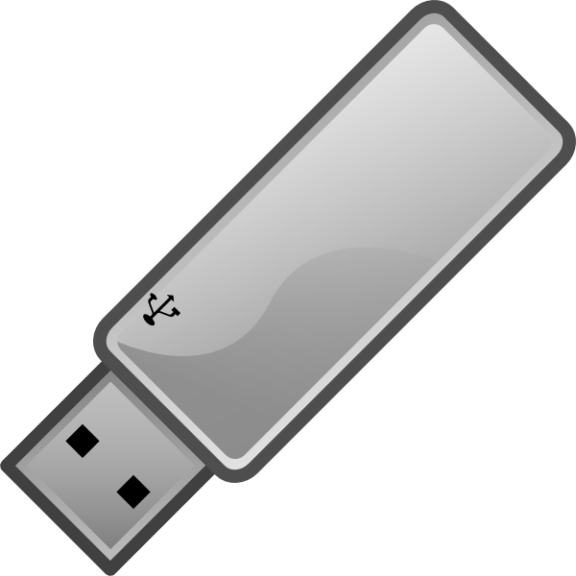
/dev/sda
/dev/sdc
/dev/sdb
Notes:
But wait Mark…. back in the example, you used sdc1 what about the 1? That 1 has to do with partition numbers… and is another video in itself and we’ll worry about that later.
Okay, that is all that I have for now, which is probably far more than enough to drive you to drink… see you guys next time!

Slide 6
Mounting Storage
“We have persistent objects, they're called files.”
Ken Thompson
Notes:
Question: How can we access storage devices on Linux? On Windows, we have a C: drive… what about Linux or UNIX?
Okay, so, the filesystem… I’ll save you the long review and just give the short version. The filesystem is organized as a tree, / the most parent folder which can have folders nested under it and those folders can have folders nested under it, and so on.

Slide 7
The Filesystem Structure
/
/bin
/home
/mnt
/var
/media
Notes:
That is all great, but you must be wondering by now how this all ends up on a disk right? I mean after all, in Windows it is pretty clear… you have the C: drive mapped to one hard disk, D: drive mapped to the CDROM, E: drive mapped to another, etc. What about on UNIX and Linux?
We’ll on UNIX and Linux, we have those device files remember? They point to a hard disk, or cdrom drive but don’t do anything terribly useful in themselves UNLESS we attach them somewhere on our file system tree.

Slide 8
The Filesystem Structure
/
/bin
/home
/home
/home
/mnt
/var
/media
Notes:
Question: What happens to the existing contents of a directory when we mount a drive to it?
So, the way it works in Linux is that we can map a mass storage device or hard drive to any location on the tree that we desire. In fact, we can mount as many different storage devices anywhere we want on our tree.

Slide 9

/
/bin
/home
/home
/mnt
/var
/media
/media/cdrom
Notes:
Once we mount a storage device or hard drive onto our tree, the contents of that device can then be accessed through where we mounted them on our tree.

Slide 10
/
/bin
/home
/home
/mnt
/var
/media
/media/cdrom
dehus
run
mp3s
Notes:
So for example, if we had a cdrom drive, that contained one folder burned on it called mp3s… if we wanted to see the contents of that folder we’d do an ls /media/cdrom/mp3s if the cdrom drive was mounted to /media/cdrom.
Or another example, if we had a hard disk mounted to /home and on that disk it contained a folder called dehus, if we wanted to see the contents of the folder on that hard drive, we’d do an ls /home/dehus. When we do this, the directory we are mounting something on is commonly referred to as a mount point.

Slide 11
/
/bin
/home
/home
/mnt
/var
/media
/media/cdrom
dehus
run
mp3s
Notes:
To further complicate matters, the root of the filesystem tree, or / is itself a mount point and is stored on some hard disk. I’m sure that is entirely to much confusion by now, so lets see if we can understand what is going on by playing around with this on the command line.
First off, I already have a mass storage device, or in this case a hard drive, that has been formatted and prepared to be mounted on our filesystem tree… we’ll explore how to prepare a hard drive for this in another video, but lets temporarily mount it somewhere.
/mnt is a great location for this because the folder was designed to be a random landing zone for storage devices.
ls /mnt
mount /dev/sdb1 /mnt
ls /mnt
Now that the storage device is mounted on /mnt, lets look at what is on it. Right now, all we see is a folder called lost+found, which is just a place for the kernel to put broken files when they are recovered from errors on the disk.
Like I said, this location was only temporary because we wanted to see what is on this disk before we mount it in a more permanent location. Lets first unmount it from /mnt… we can only have our disk mounted to one location on the filesystem at any given time.
umount /mnt
ls /mnt
Lets say we want to mount this disk on the home folder instead. Lets take a look at the existing contents of home before we do that. Right now, we see a folder called dehus with some really important files in it. Great, lets mount the hard disk that the file /dev/sdb1 points to on /home.
ls /home
ls /home/dehus
mount /dev/sdb1 /home
ls /home
ls /home/dehus
Oh no! My really important files are gone!?!? What happened here? We’ll, when we mount a hard disk on top of a folder, the existing contents that were there before are no longer accessible. You can almost think of it this way, after we ran the mount command… the home folder became a pointer to totally different hard disk that doesn’t have the same contents. How can we undo this? We’ll if we unmount /home, we’ll see that all of our existing contents are back again. Phew!
So how could we mount a new, hard disk onto /home without losing the existing contents? To do that, we must first move the existing contents onto the new hard drive. Lets temporarily mount the new hard drive on /mnt again.
mount /dev/sdb1 /mnt
Once mounted, we can issue a mv command using a shell glob to grab all the folders under /home, but not /home itself. A shell glob is like a regular expression, but simpler. I won’t go into much more detail on shell globbing than that, but it is good to know and you should explore it on your own later.
mv /home/* /mnt
ls /home
ls /mnt
Now, we can umount /mnt, and remount it to home and life is grand
umount /mnt
mount /dev/sdb1 /home
If we want to see what is currently mounted on our system, we can run the program called df, which will print out the different devices that are mounted (as paths to the specific device files) and where they are mounted on our filesystem tree. It will also give us some additional information that may be useful, such as percent utilization and amount of space used.
df
Okay, that is all I have for right now… see you guys next time!

Slide 12
Partitioning
“People sometimes ask me if it is a sin in the Church of Emacs to use vi. Using a free version of vi is not a sin; it is a penance. So happy hacking.”
Richard Stallman
Notes:
Question: What is a partition? Why would we want to use it, and what are the limits?
Partitioning, much like anything else in UNIX is filled with lots of history… history that can sometimes be important to understand how we got to where we are today with storage technology. I’m going to try and spare you as much of the history as possible and focus on what you really need to care about to get the job done.

Slide 13
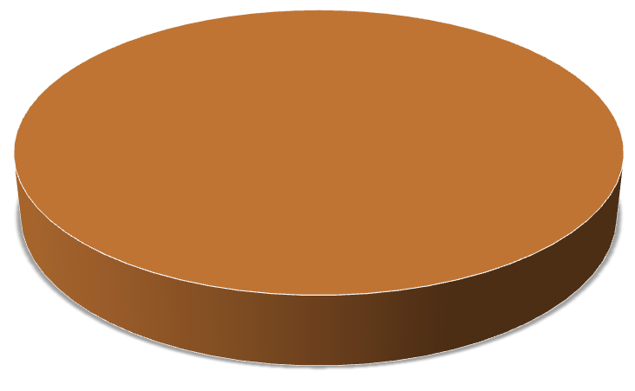
Notes:
So, to start off with, lets look at a disk. Okay, well technically this is a 3D pie chart created in Excel, but use your imagination and pretend it is a disk or more. I’m going to skip over the low level details of how a hard disk works, you should investigate that on your own, but for the meantime lets think of a hard disk as a single storage medium that has a fixed size, a starting place, and an ending place all of which we’ll define for simplicity sake in Megabytes all represented by this pie chart. Lets pretend that this pie chart represents a 100 MB hard disk, with the start being 0MB and the end being 100MB. Make sense so far?

Slide 14
100 MB Hard Disk
End (100MB)
Start (0MB)
Notes:
We have two choices that we can make with this disk. We can format the whole disk and essentially allocate the entire 100 MB to one device file that appears in /dev, which we can only mount on our filesystem tree in one specific location (like home for example) OR we can carve the 100 MB of storage up into multiple device files that we can mount in multiple locations on our filesystem tree. One way we can carve up our storage is known as partitioning.

Slide 15
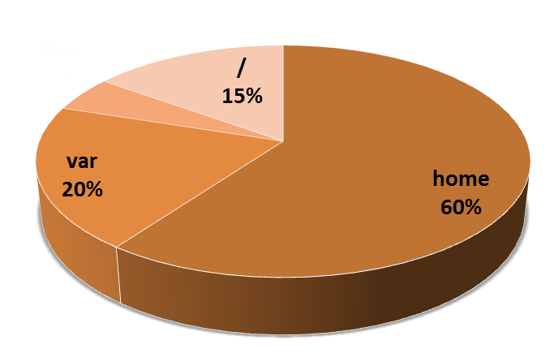
100 MB Hard Disk
Notes:
Partitioning is essentially the process of splitting our disk up into multiple partitions, that we can mount onto our filesystem tree anywhere we’d like to. Typically, we split off one portion of for each these folders: home, var, tmp, and / the root of the tree… meaning anything that is on our filesystem, that isn’t in home, var, or tmp folders.

Slide 16
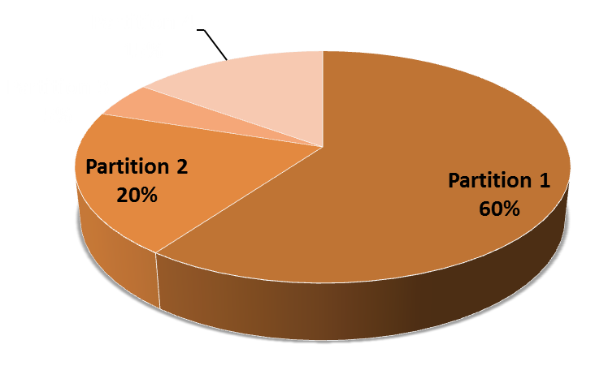
100 MB Hard Disk
Notes:
Each of these partitions that we create, are assigned a number. Remember when I talked about the naming convention for mass storage devices on Linux, but left off the part about that last number in the device file name? This number is essentially the partition number on the mass storage device. Although, if we were real computer scientist we’d start counting at zero here and the folks that wrote the Linux kernel… are real computer scientist, so the first one will always start at 0.
One other interesting thing to note is that there are currently two partitioning types that any Linux administrator really cares about. DOS partitioning and GUID partition tables or GPT. Yes, I said DOS, meaning the really old operating system originally created by Seattle Computer Products and eventually bought by Microsoft. Even though DOS is long gone, surprisingly the disk partitioning system that was created with it has lived on despite its limitations, the major one being a limit of 4 partitions…. yes, only 4 and partitions no larger than 2TB. There was some attempts to hack a solution together that would allow for more partitions, called extended partitions and it was moderately successful, but not used terribly often anymore.
The way forward is to use the latest and greatest partitioning type… GUID partition tables, or GPT. GPT doesn’t have any of these limits, and from the administrators perspective behaves the same way as long as he or she is using a tool that supports GPT to do partitioning.

Slide 17
100 MB Hard Disk
Notes:
All of that said, lets jump to the command line to see this in action. I’ve added a brand new hard disk to the machine, and connected it to the 2nd SATA port. Can you guess what the device file name will be under /dev? Come on, I know you got this…. hey, I see you heading for the time slider on this video to skip to the answer… don’t cheat! It is going to show up as /dev/sdb.
Now, lets partition this thing. I’m going to use the program called parted, which isn’t included on CentOS minimal by default, but I’ve already installed it using
yum install parted
There is another common program used called fdisk, which is great, but it doesn’t support GPT partitioning, only DOS. It is a very old tool, and the painful memories are slowly fading out of most administrators minds.
To create a partition with parted, we must first launch parted and tell it which device file points to the disk we want to partition. Now, I’m not one to live dangerously, but at this point you can either make your best guess at what name the kernel decided, look at dmesg, or run the print devices command inside parted to get details on each device file that exists which is related to storage, and select the one that best matches what you think is correct.
In this case, we can indeed see that the Linux kernel assigned our 100MB disk to /dev/sdb and we are safe to proceed. The very first thing we must do is create something called a disk label. This is just setting up the disk with the desired partitioning type we want to use, so DOS or GPT. In this case, we are going to use GPT and can do this by typing mklabel gpt
Okay, so, now that we are in parted, lets go ahead and create our first partition. Because we are adding a new disk, I’ll keep / on the old disk, /dev/sda and carve this new disk up with only 3 partitions: home, var and tmp. To create a partition, we must use the mkpart command in parted, and tell it where to start and where to end. This can either be a fixed amount, in KB, MB, GB, etc, or a percentage of the total disk space.
If we specify the start and end of the partition using KB, or MB, then the usual practice is to align partitions on 1MB boundaries, which, may result in a very, very, small loss of space, but has some performance advantages on newer Advanced Format drives. Going down this rabbit trail in further depth, is only a recipe for more confusion… so just select your start and end on 1MB boundaries and smile. You can choose to ignore parted if we’d like, but you might see a small performance hit.
mkpart primary 0 60MB
mkpart primary 1 60MB
For simplicity sake, I’m going to delete the partition I just created, start over, and just use percentages. For home I’m going to use 60%, 20% for var, and 20% for tmp to incorporate the stuff we decided not to use for / because it is staying on the old drive.
print
rm 1
mkpart primary 0% 60%
mkpart primary 60% 80%
mkpart primary 80% 100%
print
Lastly, the primary stuff you see in this command is old cruft… just write in the word primary, then the percentages and smile.
Full recipe:
yum install parted
parted
print devices
select /dev/sdb
mklabel gpt
mkpart primary 0 60000KB
mkpart primary 0 60MB
mkpart primary 1 60MB
print
rm 1
print
mkpart primary 1MB 60%
mkpart primary 60% 80%
mkpart primary 80% 100%

Slide 18
100 MB Hard Disk
Notes:
Now, the very last thing we need to do is format the partitions. What is this process of formatting you ask? We’ll the quickest and easiest way to explain formatting is to think of it this way. The mass storage device, or hard disk presents us with a whole lot of buckets or bins we can stuff our bits into. These are commonly called sectors.
The size of these buckets or sectors are either 512k or 4k, and we can only write ones and zeros to them. This is the only mechanism for organization that the hard disk or mass storage device provides, so we need software in the kernel that will break our files up into 512k or 4k chunks and store them in these sectors. When we want to retrieve a file this software must remember which sectors the file is stored in, and instruct the disk to retrieve them.
This software, is of course also called a filesystem… not to be confused with what we already know to call a filesystem, which is that tree thingy with a / at the top. It is this filesystem softwares job to store and retrieve files from the sectors on the disk and hand it to the kernel as a complete file. In order to make this filesystem software happy, we must put bits on the disk in a manner that the software will recognize. This is the process of formatting.
As with anything in life except for broadband internet provides, there are many different types of filesystem software you can choose to use. The amount of options ranges in the hundreds. I won’t spend much time listing them all and explaining the differences, but instead will focus on one that is very common on Linux called EXT, or in its latest form EXT4.
Knowing the different types of filesystem software, and under what conditions it performs best, is a good thing for a system administrator. I’ll leave this as an exercise for you to do research on your own. I will make note of one other filesystem software called b tree fs. This is a revolutionary new file system in the Linux kernel, to end partitioning, logical volumes, and RAID. If you don’t know what RAID is, you should, but I’ll leave that as another exercise for you to do research on your own.
Okay, okay, enough with all this rambling about filesystem software… lets see how we format a partition on the command line. To format, we need to use the mkfs command. mkfs will sometimes default to ext2, which is old and we don’t want that, so to be safe we need to use the -t flag to tell it what type and what device file to use.
mkfs -t ext4 /dev/sdb1
I won’t bother formatting the rest of the partitions, because I think you should get the idea by now. It is rather important to know what types of filesystem software your kernel supports, and you can do this by dumping the contents of /proc/filesystems to the screen to find out. The second column is the one we care about, it it is the names of the filesystem supported by the current running kernel. The text in the first column, nodev simply means that there are no devices currently mounted with this type of filesystem.
That is all I’ve got, see you guys next time!

Slide 19
Logical Volume Manager
“ Only wimps use tape backup: real men just upload their important stuff on ftp, and let the rest of the world mirror it ;) ”
Linus Torvalds
Notes:
Question: What are some of the limits with partitioning?
Alright… after talking about all the craziness that is partitioning, lets look at one approach that was designed to address much of the issues. The reason why I bothered talking about partitioning, is that at the end of the day, if you are going to be a good sysadmin, you still need to create at least one partition… for now.
So, what are some of the perks with logical volumes? Well, first off we can resize them. This is a major issue with partitioning, and you are left to have to keep track of where the old partition started if you want it to be useful after resizing. But we can also take snapshots, sort of like apple's time machine, but not as fully featured, and we can also move entire logical volumes from one disk to another.

Slide 20
Logical Volume
20 MB
Notes:
The most fundamental unit in the logical volume manager is a logical volume. The logical volume has a fixed sized, that can easily be adjusted later. It is almost an apples to apples comparison of a partition. It is what you format your filesystem on, and mount to the tree.

Slide 21
/var
20 MB
Notes:
Take note of this… the way we create a logical volume, is using the lvcreate command. I’m just going to throw out the names of the commands… you are going to have to explore them a bit in the lab work we are going to do today.

Slide 22
Volume Group
100MB
Logical Volume
60 MB
Logical Volume
20 MB
Logical Volume
20 MB
Notes:
A collection of logical volumes is organized into what is called a volume group. This might be a bunch of logical volumes all intended to store information for a specific purpose, such as one volume group to contain the data for a specific organizational unit, and one logical volume for each department in that organizational unit. College of engineering, department of computer science, etc.
The command to create a volume group is vgcreate.

Slide 23
Volume Group
100MB
Logical Volume
60 MB
Logical Volume
20 MB
Logical Volume
20 MB
Physical Volume
Notes:
A volume group is stored on top of some kind of physical volume, which is just a fancy word for a partition on a hard disk. Now note, that we don’t need more than one partition on a hard disk…. we only need one partition, that consumes the entire disk, to make it a physical volume. We’ll use logical volumes to carve the disk up, and then format the logical volumes with a filesystem and mount them to our tree.
Obviously, the command we used to create a physical volume on top of a partition is called pvcreate. So it goes, pvcreate, then vgcreate, then lvcreate. The physical volume must exist in order to create a volume group on it, the volume group must exist for the logical volumes to be created.

Slide 24
Volume Group
100MB
/home
60 MB
/tmp
20 MB
/var
20 MB
Physical Volume
Notes:
A volume group is stored on top of some kind of physical volume, which is just a fancy word for a partition on a hard disk. Now note, that we don’t need more than one partition on a hard disk…. we only need one partition, that consumes the entire disk, to make it a physical volume. We’ll use logical volumes to carve the disk up, and then format the logical volumes with a filesystem and mount them to our tree.

Slide 25
Volume Group
100MB
Logical Volume
60 MB
Logical Volume
20 MB
Logical Volume
20 MB
Physical Volumes
Notes:
Furthermore, we can span our volume groups across multiple physical volumes if we’d like. This is where things get interesting. We can also migrate one logical volume to another physical volume, or volume group. This is a major perk of using logical volumes.

Slide 26
Persistent Mounting
“ If you have any trouble sounding condescending, find a Unix user to show you how it's done. ”
Scott Adams (Dilbert)
Notes:
This quote might be incorrectly attributed… who knows… it is all over the interwebs, but nothing pointing out when or where he said it…. sounds like something Scott would say though.
Okay, last thing, if you mount storage device, and then reboot… you might notice that the filesystem is no longer mounted. This is of course a major problem, because nobody wants to have to manually mount all the storage on any given server after a reboot. Remember what I said about sysadmins being lazy?
Fortunately, there is a script or tool that already takes care of this for us and will mount filesystems upon boot, as defined in a certain file. This file is /etc/fstab , or file system table for short.
Now for the Lab! The write up talks about doing this on production, which may or may not be ready yet… we’re having some storage problems ironically. Regardless, I intended that in lab we’ll do this on our virtual machines so that we know how to do it… before attempting it on production, because we get a penalty if we screw up our production machines right?

